Slide 1
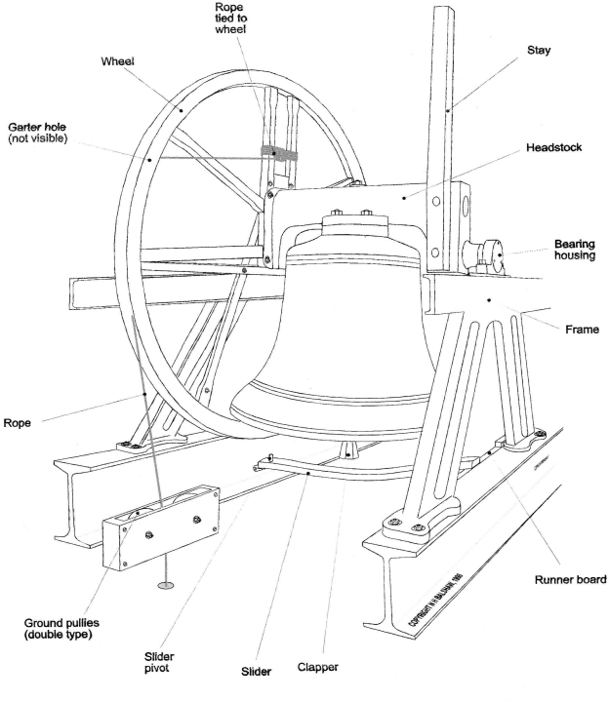
Bell Rope Maintenance and Management Workshop
Oxford Diocesan Guild
Towers & Belfries Committee

Slide 2
Programme
10.00 Tea and coffee available, pay for course
10.15 Introductions and process for the day
10.25 Tower safety (Philip Dobson)
10.35 Generic ropes talk (Richard Roberts)
10.45 Causes of rope wear – Garter hole to tail (Tony Crabtree),
11.00 Short splicing demonstration (Richard Roberts)
11.15 Short splicing by students
12.45 Lunch (picnic lunch)
12.45 View bell wheel and other artefacts over lunch
13.15 Long splicing demonstration (Philip Dobson)
13.30 Long splicing by students and activities to suit.
14.30 Final Q&A session.
14.45 Tidy, pack and close

Slide 3
Process For The Day
Have pen & paper handy
Ask questions – but also…
Note things you might want to follow up
Save long discussions for later –there is plenty of time after the presentations
Small groups or 1:1 as appropriate
There will be things you have never thought about until today!
We can arrange follow-up after the course
Consider buying one of the books on sale today
Splicing fids on sale
Think about joining the general belfry course or hands-on belfry course
Towers and Belfries Sub-Committee - Oxford Diocesan Guild of Church Bell Ringers (odg.org.uk)

Slide 4

What is Health and Safety?
Health and Safety is about protecting ourselves and others from injury or illness
It’s not about preventing you from doing what you want to do or have traditionally done.

Slide 5
Golden Rules
Never work in the tower alone
Ensure someone knows where you are and when you are expected to finish
Use protective equipment especially if there are bird droppings in the tower
Never work on bells that are up
Pull off any clock hammers!
Put out warning signs if people are working upstairs
Consult professional Bellhangers if in doubt
Log maintenance sessions in a tower log book

Slide 6
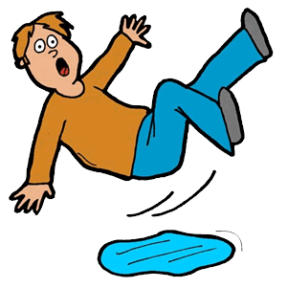
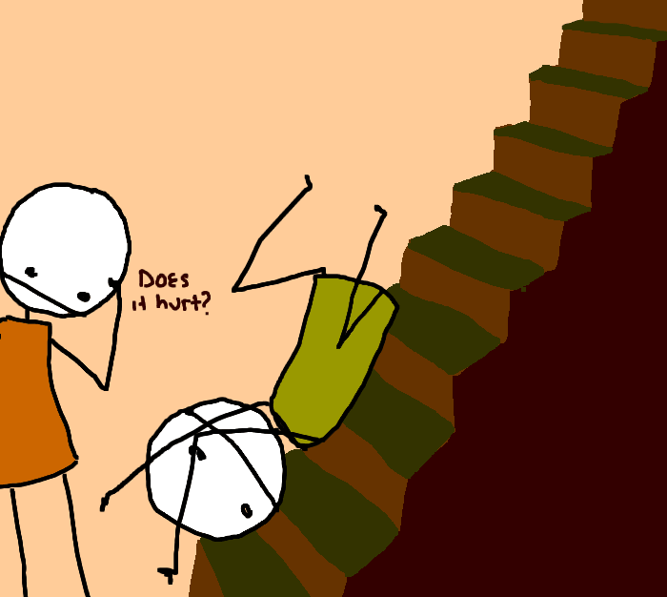





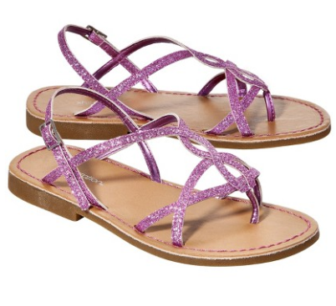
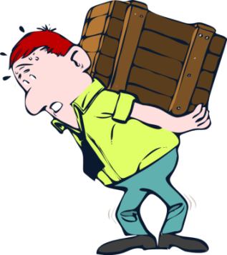
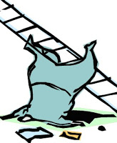
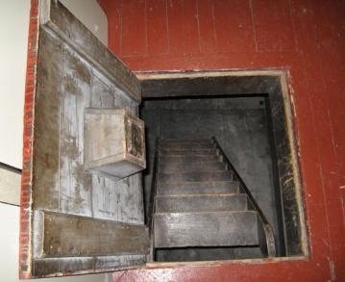
Risks in the belfry
Slips and Trips
Fire
Lone Working
Falling
Experience
Lighting
Ability
Bells in unsafe position
Power Failure
Fitness
Working at height
Access
Unauthorised visitors
Jewellery
Heavy items
Clothing
Noise

Slide 7
Different Types of Ropes
Boating ropes, climbing ropes etc all have different requirements
  What do we require of a bell rope?
“Pre-stretched” polyester
  used for top ends (only slightly more expensive than hemp).
  Vermin and rot resistant
  Don’t go up or down in wet/dry weather
  SHOULD be non-stretch but… If the bell rope maker inadvertently sourced poor rope, it will always stretch and make the bell “hard work”
Hemp used for tail ends, sallies and less frequently nowadays: top ends.
  Kind to the hands
All ropes MUST be stretched before use.
  The tail & sally must be stretched even if the top is “pre-stretched”
  Tie a heavy weight on the tail!
  If, after stretching, the rope is still too stretchy, consider getting back to your supplier for advice.

Slide 8
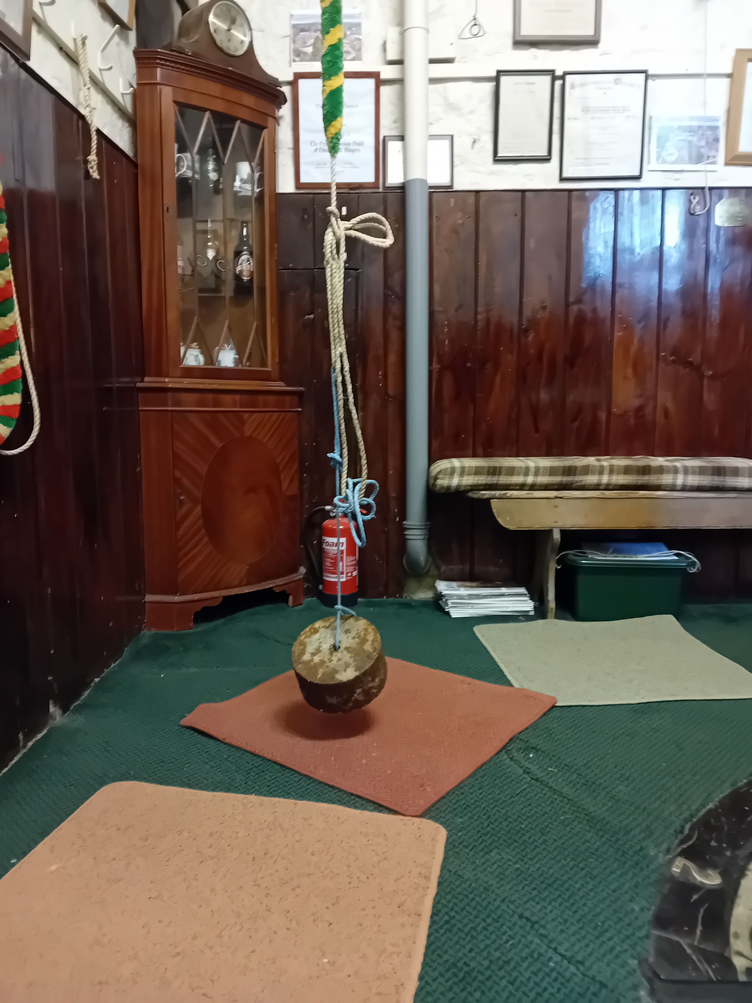
Stretching a Rope
Remember: most ropes stretch so bell ropes are specially made
After installing, they need the last bits of stretch removing.
Ropes don’t lose their stretch simply with ringing!
N.B. a terylene top may have stretch in which case it should be replaced as it will never lose its stretch

Slide 9
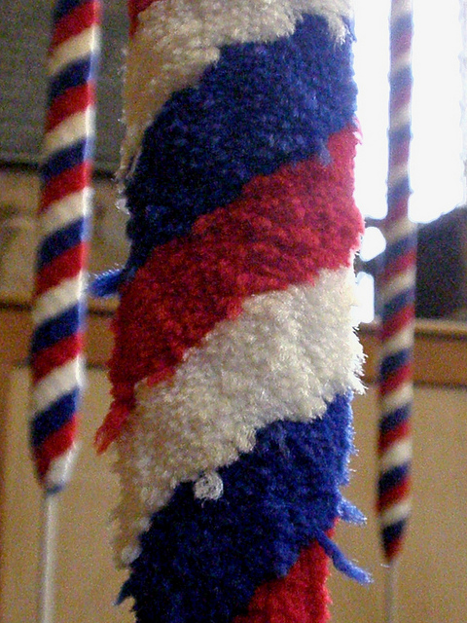
Ropes
Sally
Garter Hole
Bosses
Tail end
Splices
All ropes can break and most breaks can be spliced. However, WHY did the rope break and can the cause of wear be reduced or eliminated?

Slide 10
Identifying problems

Slide 11
Rope Wear – Garter Hole to Tail – 1
(with wheel, rope, pulleys, ceiling bosses etc)
Garter hole
  Protecting sleeves
  Protect garter holes with “bobbins”
  Beware of hidden sharp edges
Wheel
  Beware of splinters, protruding nails, screws etc
  Warped, thus wearing rope on the shrouding
  Watch rope travel with bell ringing (carefully & safely) with clapper tied
Pulley
  Warped wheel rubs rope down side of pulley box in certain position
  Out of line with wheel. Rope rubs pulley box all the time
  Stiff or worn
  Hidden sharps!
Flapping boards
  Out of line, rough or otherwise not allowing smooth passage
  Watch while bell ringing (carefully & safely) with clapper tied

Slide 12
Rope Wear – Garter Hole to Tail – 2
(with wheel, rope, pulleys, ceiling bosses etc)
Ceiling bosses
  In line
  If not, do they need intermediate pulleys?
  Nice and smooth
Rope guide (if fitted)
  At the right height
    tenor sally doesn’t go right through
    treble sally (probably) just reaches it
    Too high and sallies “bounce” coming down.
    Too low and sally tops wear prematurely
  Bosses smooth and with rounded edges?
Sallies wear increased by low ceilings
  Mitigate with
    special ceiling bosses
    Sally top protecting sleeves
    Maybe also special tapered sallies

Slide 13
Rope Management
Check the ropes at least every month. More frequent if heavily used.
If tail worn, replace only tail. If top is worn, replace only top.
If sally expired replace rope and keep top & tail for repairs on other ropes!
Extend rope life with polyester tops
Move hemp rope (and protecting sleeve) position in garter hole periodically
Replace/repair poor pulleys, flap boards, bosses, guides, wheels etc (Faculty?)
Reposition rope guides (if at wrong height). Needs faculty
Rope tail-end drier
  Stiff ropes wear faster at any weak point.
  Supple rope easier to ring!
Have stock of appropriate size boxes to minimise tail-end adjustment
Mats or carpet where ropes land on floor
Tuck in tail ends properly
NO sticky tape etc on tail-ends
  Tuck tail-end properly or supply scissors & string for nervous peal ringers!
Washing ropes was discussed in the Ringing World (5th October 2018, p 952)

Slide 14
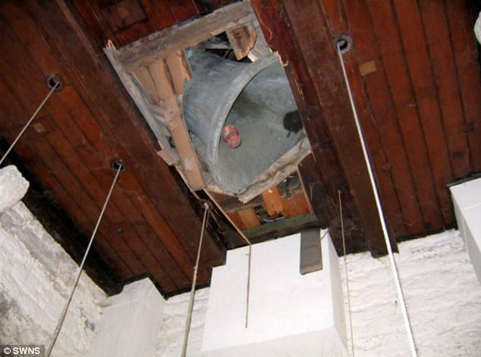
Seeking help
If anything seems wrong or untoward or if in doubt always consult the experts for assistance.
ODG T&B committee members always available or consult a Bell Hanger.
Our job in the tower is to do routine maintenance and regular checks.
DO NOT ATTEMPT ANYTHING OTHER THAN VERY MINOR WORK YOURSELF

Slide 15
Gaining Permission….
Never carry out work without the permission of the PCC
Remember who owns the building and its fittings – including the bells
Give the PCC an annual report on condition. Invite the Vicar or Church Warden to chair your tower AGM
Many tasks require a faculty or permission from the diocese
  The diocese website will give guidance
  Ask T&B member r your DAC Bells Advisor if you need further clarity
Listed buildings may require other consents –
  Historic England
  Victorian Society
  SPAB etc etc

Slide 16
Maintenance schedule
Monthly – check tails & sallies
Monthly – check ropes above sallies
Quarterly – check polyester ropes above sallies
Half yearly – check rope runs for any new splinters, roughness or snagging

Slide 17
Types of Splice
Short splice
  splice not going over pulleys
  bulky – six strands thick
  back splice & eye splice (clever short splices!)
Long splice
  only three or four strands thick
  splice over pulleys
  through garter hole

Slide 18
Artefacts
Model bell
Pulleys
Wheel
Bosses
Ropes
Sally shields
Garter hole sleeves
Polyester

Slide 19
Towers & Belfries Advice and Help
Towers and Belfries Sub-Committee - Oxford Diocesan Guild of Church Bell Ringers (odg.org.uk)
Apply to ODG Bell Fund – grant scheme applications and inspections
Belfry Inspections
Belfry Safety
Courses – all aspects of tower and rope maintenance and the potential for minor improvements.
Helpful documents, links, and videos – including clappers, risk assessments, odd struckness.
ODG Tower Maintenance Award Scheme
  TMA Reports
Redundant bells – information about exchanging between ODG, CCCBR and others
Restoration and Rehanging – including maintenance, minor improvements, finding volunteer helpers
Rope Splicing – books, videos and pictures of rope splicing and maintenance
Towers and Belfries – Records (Team Members)
Towers and Belfries Sub-Committee Terms of Reference
Towers and Belfries team
To contact the sub-committee, please email the Chairman or Secretary.

